Slide 1
Logistic Regression with more than two outcomes
This slide show is a free open source document.
See the last slide for copyright information.

Slide 2
If there are k outcomes
Think of k-1 dummy variables for the response variable

Slide 3
Model for three categories
Need k-1 generalized logits to represent a response
variable with k categories

Slide 4
Meaning of the regression coefficients
A positive regression coefficient for logit j means that higher
values of the explanatory variable are associated with
greater chances of response category j, compared to
the reference category.

Slide 5
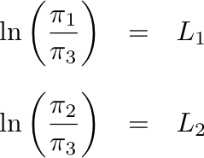
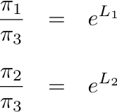
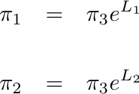
Solve for the probabilities
so
So
Notes:
Two linear equations in two unknowns

Slide 6
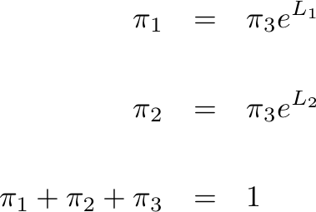
Three linear equations in 3 unknowns

Slide 7
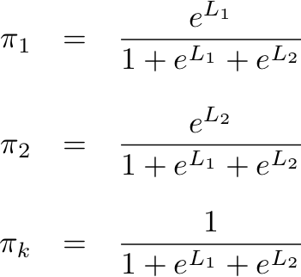
Solution

Slide 8
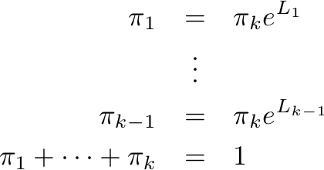
In general, solve k equations in k unknowns

Slide 9
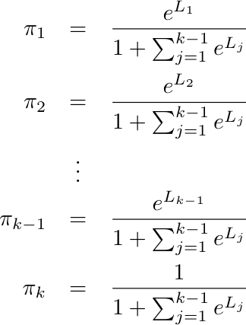
General Solution

Slide 10
Using the solution, one can
Calculate the probability of obtaining the observed data as a function of the regression coefficients: Get maximum likelihood estimates (b values)
From maximum likelihood estimates, get tests and confidence intervals
Using b values in L_{j}, estimate probabilities of category membership for any set of x values.

Slide 11
Copyright Information
This slide show was prepared by Jerry Brunner, Department of Statistical Sciences, University of Toronto. It is licensed under a Creative Commons Attribution - ShareAlike 3.0 Unported License. Use any part of it as you like and share the result freely. These Powerpoint slides are available from the course website:
http://www.utstat.toronto.edu/~brunner/oldclass/441s16

