Slide 1
Multinomial Logit Models
STA 312 Fall 2022
See last slide for copyright information

Slide 2
Logistic Regression with more than two outcomes
Ordinary logistic regression has a linear model for one response function
Multinomial logit models for a response variable with c categories have c-1 response functions.
Linear model for each one
It’s like multivariate regression.

Slide 3
Model for three categories
Need k-1 generalized logits to represent a dependent
variable with k categories

Slide 4
Meaning of the regression coefficients
A positive regression coefficient for logit j means that higher
values of the independent variable are associated with
greater chances of response category j, compared to
the reference category.

Slide 5
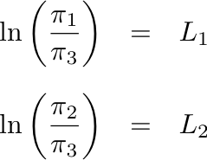
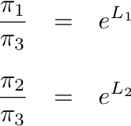
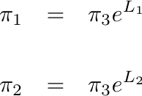
Solve for the probabilities
so
So
Notes:
Two linear equations in two unknowns

Slide 6
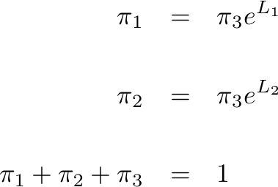
Three linear equations in 3 unknowns

Slide 7
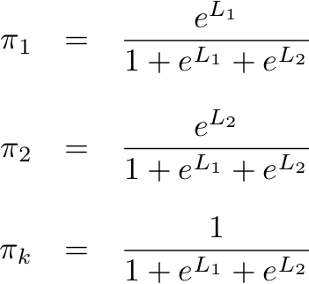
Solution

Slide 8
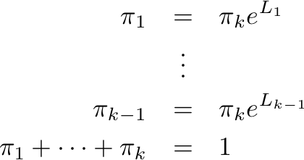
In general, solve k equations in k unknowns

Slide 9
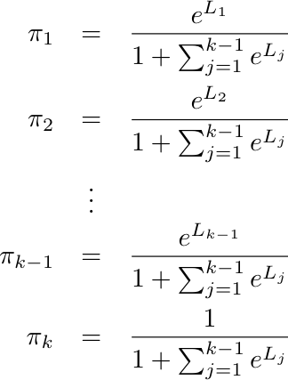
General Solution

Slide 10
Using the solution, one can
Calculate the probability of obtaining the observed data as a function of the regression coefficients: Get maximum likelihood estimates (beta-hat values)
From maximum likelihood estimates, get tests and confidence intervals
Using beta-hat values in L_{j}, estimate probabilities of category membership for any set of x values.

Slide 11
R’s mlogit package
Not part of the base installation
You need to download it
Can (should) do so from within R

Slide 12
Getting the mlogit package
In Packages and Data, select Package Installer.
Click on Get List.
Maybe pick a mirror site.
Select mlogit from a long list of packages.
With Install Dependencies selected, click Install Selected.
Once installation is finished, quit R.
Start R again.
Type library(mlogit), or in Packages and Data, select Package Manager and check mlogit.

Slide 13
Handle with Care
The mlogit package is complicated and tricky to use compared to core R functions like lm and glm.
I can shield you from most of it.
But it requires a special kind of data frame.
There’s a function for converting an ordinary data frame to one of the kinds mlogit can use.
And the syntax of the model specification is unusual.

Slide 14
The complexity is justified
Because the mlogit function can do a lot more than the multinomial logit model presented here.
In addition to explanatory variables specific to the individual (like income), there can be explanatory variables specific to the categories of the response variable.
Like if the response is what car the person buys, the prices of the cars can be an explanatory variable.

Slide 15
It gets even better
There can even be alternative-specific explanatory variables that are different for different individuals, like the years of experience of the salesperson who was selling each type of car that day.
And the model can accommodate several choices among the same set of alternatives by each individual. Like try the coffees three times.

Slide 16
It’s really impressive
The models can seemingly allow the discrete outcomes to be determined by unobservable continuous variables – a kind of threshold idea.
This was designed by econometricians; can you tell?
They are interested in economic choices.
We will be less ambitious, and focus on logistic regression for a multinomial response variable with 2 or more categories.
This will allow us to avoid most of the extra complexity, but not all.

Slide 17
Copyright Information
This slide show was prepared by Jerry Brunner, Department of
Statistics, University of Toronto. It is licensed under a Creative
Commons Attribution - ShareAlike 3.0 Unported License. Use
any part of it as you like and share the result freely. These
Powerpoint slides will be available from the course website:
http://www.utstat.toronto.edu/brunner/oldclass/312f22

