Slide 1
Logistic Regression
Part One
STA312F 2022
See last slide for copyright information

Slide 2
Suggested Reading
In Ch. 3, skim pages 65-68; we’ll come back to generalized linear models later.
Read pages 68-73 about logistic regression.
Read Chapter 4.
The discussion of dummy variables in lecture may be clearer than the text’s.
Exactly what do you need to know? See homework problems.

Slide 3
Logistic Regression
For a binary dependent variable: 1=Yes, 0=No
Notes:
Data analysis text has a lot of this stuff
Pr\{Y=1|\mathbf{X}=\mathbf{x}\} = \pi % 42

Slide 4
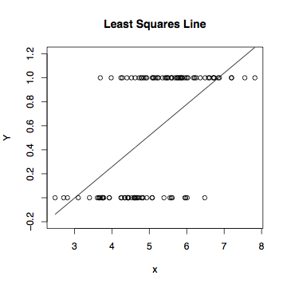
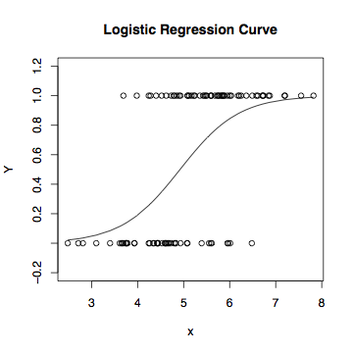
Least Squares vs. Logistic Regression

Slide 5
Linear regression model for the log odds of the event Y=1
Notes:
Beta0 is the intercept.
$\beta_k$ is the increase in log odds of $Y=1$ when $x_k$ is increased by one unit,
and all other independent variables are held constant.
\begin{equation*}
\log\left(\frac{\pi}{1-\pi} \right) =
\beta_0 + \beta_1 x_1 + \ldots + \beta_{p-1} x_{p-1}.
\end{equation*} % 32
Note $\pi$ is a \emph{conditional} probability. % 32

Slide 6
Equivalent Statements
Notes:
Odds RATIOS will yield nice cancellation
\begin{equation*}
\log\left(\frac{\pi}{1-\pi} \right) =
\beta_0 + \beta_1 x_1 + \ldots + \beta_{p-1} x_{p-1}.
\end{equation*} % 32
\begin{eqnarray*}
\frac{\pi}{1-\pi}
& = & e^{\beta_0 + \beta_1 x_1 + \ldots + \beta_{p-1} x_{p-1}} \\
& = & e^{\beta_0} e^{\beta_1 x_1} \cdots e^{\beta_{p-1} x_{p-1}}, \nonumber
\end{eqnarray*} % 32
\begin{displaymath}
\pi = \frac{e^{\beta_0 + \beta_1 x_1 + \ldots + \beta_{p-1} x_{p-1}}}
{1+e^{\beta_0 + \beta_1 x_1 + \ldots + \beta_{p-1} x_{p-1}}}
\end{displaymath} % 32

Slide 7
A distinctly non-linear function
Non-linear in the betas
So logistic regression is an example of non-linear regression.

Slide 8
Could use any cumulative distribution function:
CDF of the standard normal used to be popular
Called probit analysis
Can be closely approximated with a logistic regression.

Slide 9
In terms of log odds, logistic regression is like regular regression
Notes:
Beta0 is intercept, beta_k is …

Slide 10

In terms of plain odds,
(Exponential function of) the logistic regression coefficients are odds ratios
For example, “Among 50 year old men, the odds of being dead before age 60 are three times as great for smokers.”
Notes:
Remember, alpha is an odds ratio

Slide 11


Logistic regression
X=1 means smoker, X=0 means non-smoker
Y=1 means dead, Y=0 means alive
Log odds of death =
Odds of death =

Slide 12
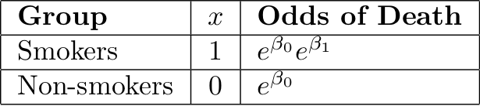


Slide 13
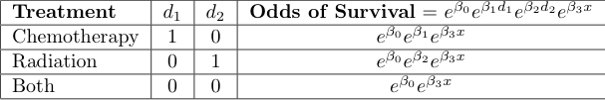
Cancer Therapy Example
x is severity of disease
Notes:
X = disease severity

Slide 14

For any given disease severity x,
Notes:
What if beta1 > 0 ? Chemo alone is better. Reasonable?

Slide 15
In general,
When x_{k} is increased by one unit and all other independent variables are held constant, the odds of Y=1 are multiplied by
That is, is an odds ratio --- the ratio of the odds of Y=1 when x_{k} is increased by one unit, to the odds of Y=1 when everything is left alone.
As in ordinary regression, we speak of “controlling” for the other variables.

Slide 16
The conditional probability of Y=1
This formula can be used to calculate a predicted
P(Y=1|x). Just replace betas by their estimates
It can also be used to calculate the probability of getting
the sample data values we actually did observe, as a
function of the betas.
Notes:
Nonlinear model for the probability

Slide 17
Likelihood Function
Notes:
And that’s about it.

Slide 18
Maximum likelihood estimation
Likelihood = Conditional probability of getting the data values we did observe,
As a function of the betas
Maximize the (log) likelihood with respect to betas.
Maximize numerically (“Iteratively re-weighted least squares”)
Likelihood ratio tests as usual
Divide regression coefficients by estimated standard errors to get Z-tests of H₀: β_{j}=0.
These Z-tests are like the t-tests in ordinary regression.
Notes:
No details about the numerical method

Slide 19
Copyright Information
This slide show was prepared by Jerry Brunner, Department of
Statistics, University of Toronto. It is licensed under a Creative
Commons Attribution - ShareAlike 3.0 Unported License. Use
any part of it as you like and share the result freely. These
Powerpoint slides will be available from the course website:
http://www.utstat.toronto.edu/brunner/oldclass/312f22

