Slide 1
Logistic Regression
STA 2101 Fall 2019
See last slide for copyright information

Slide 2
Binary outcomes are common and important
The patient survives the operation, or does not.
The accused is convicted, or is not.
The customer makes a purchase, or does not.
The marriage lasts at least five years, or does not.
The student graduates, or does not.

Slide 3
Logistic Regression
Response variable is binary (Bernoulli): 1=Yes, 0=No
Notes:
Data analysis text has a lot of this stuff
Pr\{Y=1|\mathbf{X}=\mathbf{x}\} = E(Y|\mathbf{X}=\mathbf{x}) = \pi % 36

Slide 4
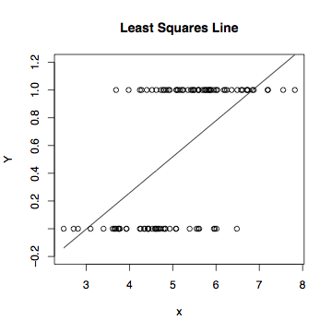
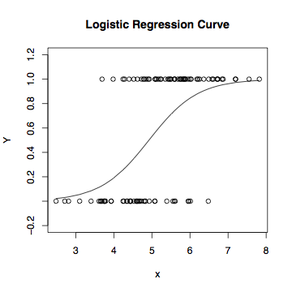
Least Squares vs. Logistic Regression

Slide 5

The logistic regression curve arises from an indirect
representation of the probability of Y=1 for a given set
of x values.
Representing the probability of an event by
Notes:
A number between 0 and 1, not 3.14159…

Slide 6
If P(Y=1)=1/2, odds = .5/(1-.5) = 1 (to 1)
If P(Y=1)=2/3, odds = 2 (to 1)
If P(Y=1)=3/5, odds = (3/5)/(2/5) = 1.5 (to 1)
If P(Y=1)=1/5, odds = .25 (to 1)
Notes:
Always “to 1”

Slide 7

The higher the probability, the greater the odds

Slide 8
Linear regression model for the log odds of the event Y=1 for i = 1, …, n
Notes:
Beta0 is the intercept.
$\beta_k$ is the increase in log odds of $Y=1$ when $x_k$ is increased by one unit,
and all other explanatory variables are held constant.
\begin{equation*}
\log\left(\frac{\pi}{1-\pi} \right) =
\beta_0 + \beta_1 x_1 + \ldots + \beta_{p-1} x_{p-1}.
\end{equation*} % 32
Note $\pi$ is a \emph{conditional} probability. % 32

Slide 9
Equivalent Statements
Notes:
Odds RATIOS will yield nice cancellation
\begin{equation*}
\log\left(\frac{\pi}{1-\pi} \right) =
\beta_0 + \beta_1 x_1 + \ldots + \beta_{p-1} x_{p-1}.
\end{equation*} % 32
\begin{eqnarray*}
\frac{\pi}{1-\pi}
& = & e^{\beta_0 + \beta_1 x_1 + \ldots + \beta_{p-1} x_{p-1}} \\
& = & e^{\beta_0} e^{\beta_1 x_1} \cdots e^{\beta_{p-1} x_{p-1}}, \nonumber
\end{eqnarray*} % 32
\begin{displaymath}
\pi = \frac{e^{\beta_0 + \beta_1 x_1 + \ldots + \beta_{p-1} x_{p-1}}}
{1+e^{\beta_0 + \beta_1 x_1 + \ldots + \beta_{p-1} x_{p-1}}}
\end{displaymath} % 32

Slide 10
A distinctly non-linear function
Non-linear in the betas
So logistic regression is an example of non-linear regression.
Notes:
\begin{displaymath}
E(Y|\mathbf{x}) = \pi =
\frac{e^{\beta_0 + \beta_1 x_1 + \ldots + \beta_{p-1} x_{p-1}}}
{1+e^{\beta_0 + \beta_1 x_1 + \ldots + \beta_{p-1} x_{p-1}}}
\end{displaymath} % 32

Slide 11
Could use any cumulative distribution function:
CDF of the standard normal used to be popular
Called probit analysis
Can be closely approximated with a logistic regression.
Notes:
$F(x) = \frac{e^x}{1+e^x}$ is called the \emph{logistic distribution}.
\pi = F(\beta_0 + \beta_1 x_1 + \ldots + \beta_{p-1} x_{p-1}}) % 32

Slide 12
In terms of log odds, logistic regression is like regular regression
Notes:
Beta0 is intercept, beta_k is …
\begin{equation*}
\log\left(\frac{\pi}{1-\pi} \right) =
\beta_0 + \beta_1 x_1 + \ldots + \beta_{p-1} x_{p-1}.
\end{equation*} % 32

Slide 13

In terms of plain odds,
(Exponential function of) the logistic regression coefficients are odds ratios
For example, “Among 50 year old men, the odds of being dead before age 60 are three times as great for smokers.”
Notes:
Remember, alpha is an odds ratio

Slide 14


Logistic regression
X=1 means smoker, X=0 means non-smoker
Y=1 means dead, Y=0 means alive
Log odds of death =
Odds of death =

Slide 15
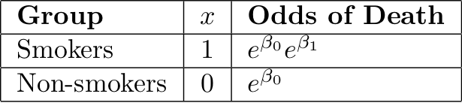


Slide 16
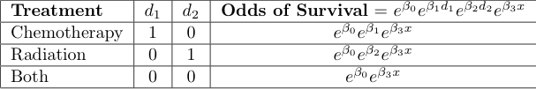
Cancer Therapy Example
x is severity of disease
Notes:
X = disease severity

Slide 17

For any given disease severity x,
Notes:
What if beta1 > 0 ? Chemo alone is better. Reasonable?

Slide 18
In general,
When x_{k} is increased by one unit and all other explanatory variables are held constant, the odds of Y=1 are multiplied by
That is, is an odds ratio --- the ratio of the odds of Y=1 when x_{k} is increased by one unit, to the odds of Y=1 when everything is left alone.
As in ordinary regression, we speak of “controlling” for the other variables.

Slide 19
The conditional probability of Y=1
This formula can be used to calculate a predicted
P(Y=1|x). Just replace betas by their estimates
It can also be used to calculate the probability of getting
the sample data values we actually did observe, as a
function of the betas.
Notes:
\begin{eqnarray*}
\pi_i &=& \frac{e^{\beta_0 + \beta_1 x_{i,1} + \ldots + \beta_{p-1} x_{i,p-1}}}
{1+e^{\beta_0 + \beta_1 x_{i,1} + \ldots + \beta_{p-1} x_{i,p-1}}} \\
&&\\
&=& \frac{e^{\mathbf{x}_i^\top \boldsymbol{\beta}}}
{1+e^{\mathbf{x}_i^\top \boldsymbol{\beta}}}
\end{eqnarray*} % 32

Slide 20
Likelihood Function
Notes:
\begin{eqnarray*}
L(\boldsymbol{\beta})
&=& \prod_{i=1}^n P(Y_i=y_i|\mathbf{x}_i)
= \prod_{i=1}^n \pi_i^{y_i} (1-\pi_i)^{1-y_i} \\
&=& \prod_{i=1}^n \left( \frac{e^{\mathbf{x}_i^\top \boldsymbol{\beta}}}
{1+e^{\mathbf{x}_i^\top \boldsymbol{\beta}}}
\right)^{y_i}
\left(1 - \frac{e^{\mathbf{x}_i^\top \boldsymbol{\beta}}}
{1+e^{\mathbf{x}_i^\top \boldsymbol{\beta}}}
\right)^{1-y_i} \\
&=& \prod_{i=1}^n \left( \frac{e^{\mathbf{x}_i^\top \boldsymbol{\beta}}}
{1+e^{\mathbf{x}_i^\top \boldsymbol{\beta}}}
\right)^{y_i}
\left( \frac{1}
{1+e^{\mathbf{x}_i^\top \boldsymbol{\beta}}}
\right)^{1-y_i} \\
&=& \prod_{i=1}^n \frac{e^{y_i\mathbf{x}_i^\top \boldsymbol{\beta}}}
{1+e^{\mathbf{x}_i^\top \boldsymbol{\beta}}} \\
&=& \frac{e^{\sum_{i=1}^n y_i\mathbf{x}_i^\top \boldsymbol{\beta}}}
{\prod_{i=1}^n \left( 1+e^{\mathbf{x}_i^\top \boldsymbol{\beta}} \right)}
\end{eqnarray*} % 24

Slide 21
Maximum likelihood estimation
Likelihood = Conditional probability of getting the data values we did observe,
As a function of the betas
Maximize the (log) likelihood with respect to betas.
Maximize numerically (“Iteratively re-weighted least squares”)
Likelihood ratio, Wald tests as usual
Divide regression coefficients by estimated standard errors to get Z-tests of H₀: β_{j}=0.
These Z-tests are like the t-tests in ordinary regression.
Notes:
No details about the numerical method

Slide 22
Copyright Information
This slide show was prepared by Jerry Brunner, Department of
Statistics, University of Toronto. It is licensed under a Creative
Commons Attribution - ShareAlike 3.0 Unported License. Use
any part of it as you like and share the result freely. These
Powerpoint slides are available from the course website:
http://www.utstat.toronto.edu/brunner/oldclass/2101f19

